Slide 1
Predicting the severity of road accidents
IBM Applied Capstone Project
Alfred Appiah

Slide 2
Introduction and Business Problem
Nearly 1,800 people died in 2018 in the UK due from reported road accidents
Additional 25,000 suffered various degrees of injuries
Severity of road accidents depends on multiplicity of factors
Intent of the project is to build a machine learning classification model
Model will predict severity based on available factors like road and weather conditions, driver and vehicle characteristics
Model will support transportation policy development

Slide 3
Data
Data from Kaggle (https://www.kaggle.com/tsiaras/uk-road-safety-accidents-and-vehicles)
Two datasets
One with accident information
Other with vehicle information
Both data can be merged using a unique ID
Data has a variable on accident severity (slight, severe and fatal) to be used as target variable
Target variable is imbalanced with about 86% of records belonging to the slight classes
Poses problems for modelling and need to be addressed
Features relate to road and weather conditions, driver and vehicle characteristics

Slide 4
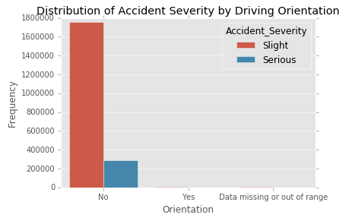
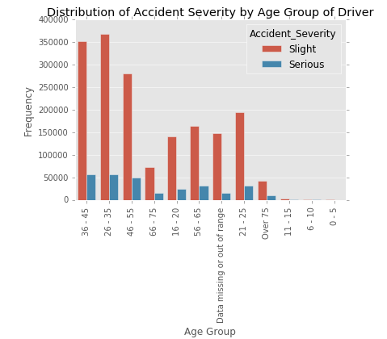
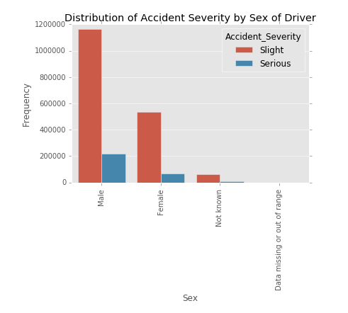
Exploratory data analysis
Vehicle Characteristics
Driver Characteristics

Slide 5
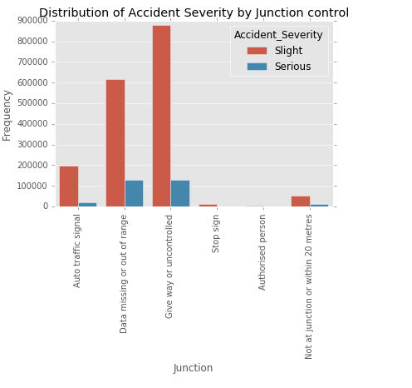
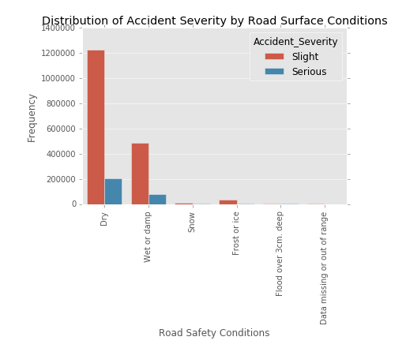
Exploratory data analysis cont’d
Road and Weather Characteristics
Majority of accidents occurred on uncontrolled junction and on dry road surfaces

Slide 6
Feature Engineering
Recoded all missing values improperly coded as valid data
Dropped all rows with missing values instead of imputation due to the large volume of data
Normalized numerical features
Created time features from the time variable to reflect various activities of the day
One hot encoding of all categorical features

Slide 7
Model Estimation and Evaluation
Split into training and testing sets based on the years of the accidents
Accidents from 2005 to 2013 used as training set
Accidents from 2014 to 2016 used as testing set
Applied SMOTE to address imbalanced target variable
Applied only on the training test
Estimated three classification models
Decision tree
Random forest
Logistic regression
Tested models using the test dataset
Weighted f1-score and confusion matrix used as evaluation metrics

Slide 8
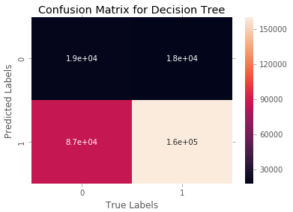
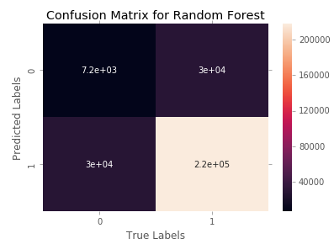
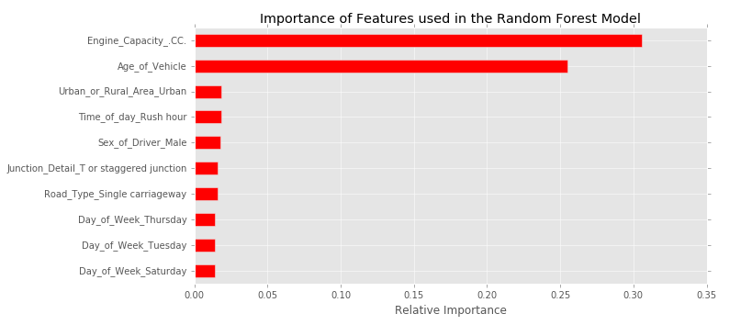
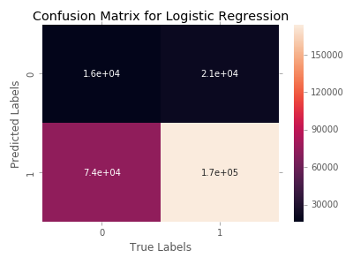
Results
Based on evaluation metrics, best performing model was the random forest
Top two best predictors were engine capacity and age of vehicle
Model | Weighted average recall | Weighted average f1-score
Decision Tree | 0.63 | 0.69
Random Forest | 0.79 | 0.79
Logistic Regression | 0.67 | 0.72

Slide 9
Conclusions
Features within the control of public authorities are the best predictors of severity of accidents
Reinforces the need to focus on those features in policy formulation

